Slide 1


Effectiveness of Individual Development Plans (IDPs) in Support of Student Success: Outcomes from a Survey of Postdocs
Dorthe Wildenschild, Associate Dean, College of Engineering, Oregon State University
Tori Byington, Assistant Dean, Graduate School, University of Oregon

Slide 2

Why use IDPs?
There is a body of literature that underscores the value of deliberate career planning:
people who develop and implement strategies to pursue career-specific goals achieve greater career success as measured by salary, promotions, and level of responsibility.¹
they also report greater career satisfaction and rate themselves as more successful than their peers compared to those without career plans.²
IDPs are quite common in the private sector, but only relatively recently introduced in higher education
¹ Ng T. W. H, Eby L. T., Sorensen K. L., and Feldman D. C. (2005). “Predictors of objective and subjective career success: A meta-analysis.” Personnel Psychology, 58, 367–408.
² Abele A. E. and Wiese B. S. (2008). “The nomological network of self-management strategies and career success.” Journal of Occupational and Organizational Psychology, 81, 733-749.

Slide 3

What is an IDP?
https://myidp.sciencecareers.org/
An Individual Development Plan (IDP) is a tool designed to help graduate individuals (students, postdocs) to
(1) identify professional goals and objectives;
(2) assess an individual’s skill set relative to their career goals; and
(3) develop a plan to acquire the skills and competencies needed to achieve short- and long-term career objectives.
A well-crafted IDP can serve as both a planning and a communications tool, allowing graduate students and postdocs to identify their career goals and to communicate these goals to mentors and advisors

Slide 4
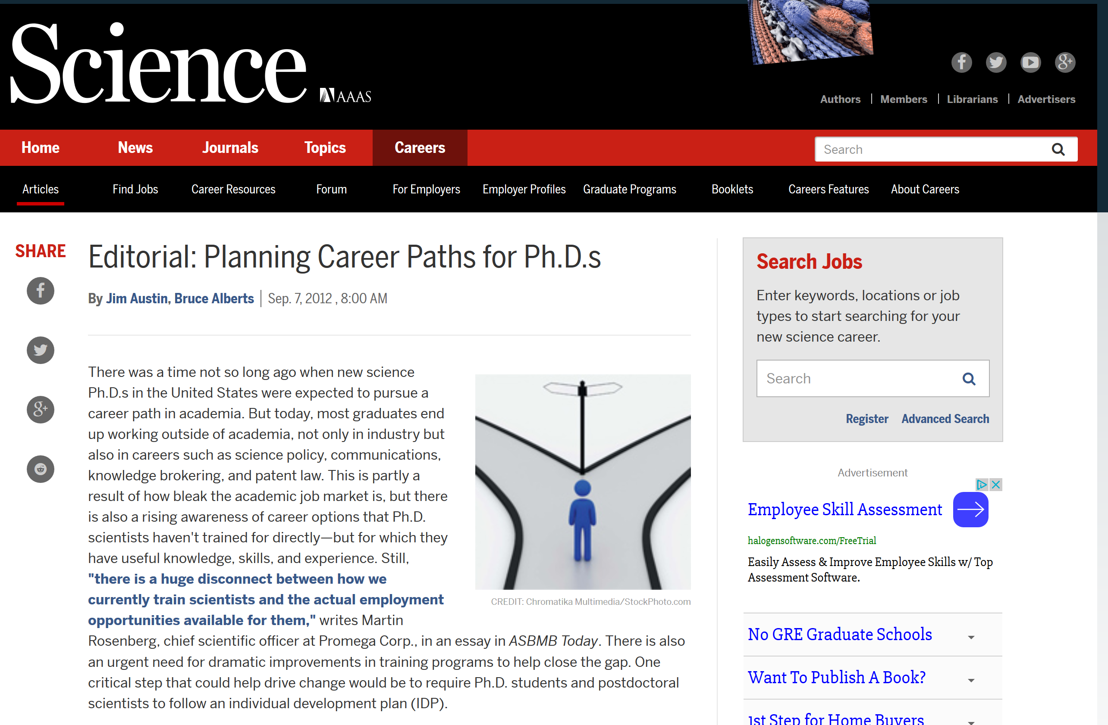
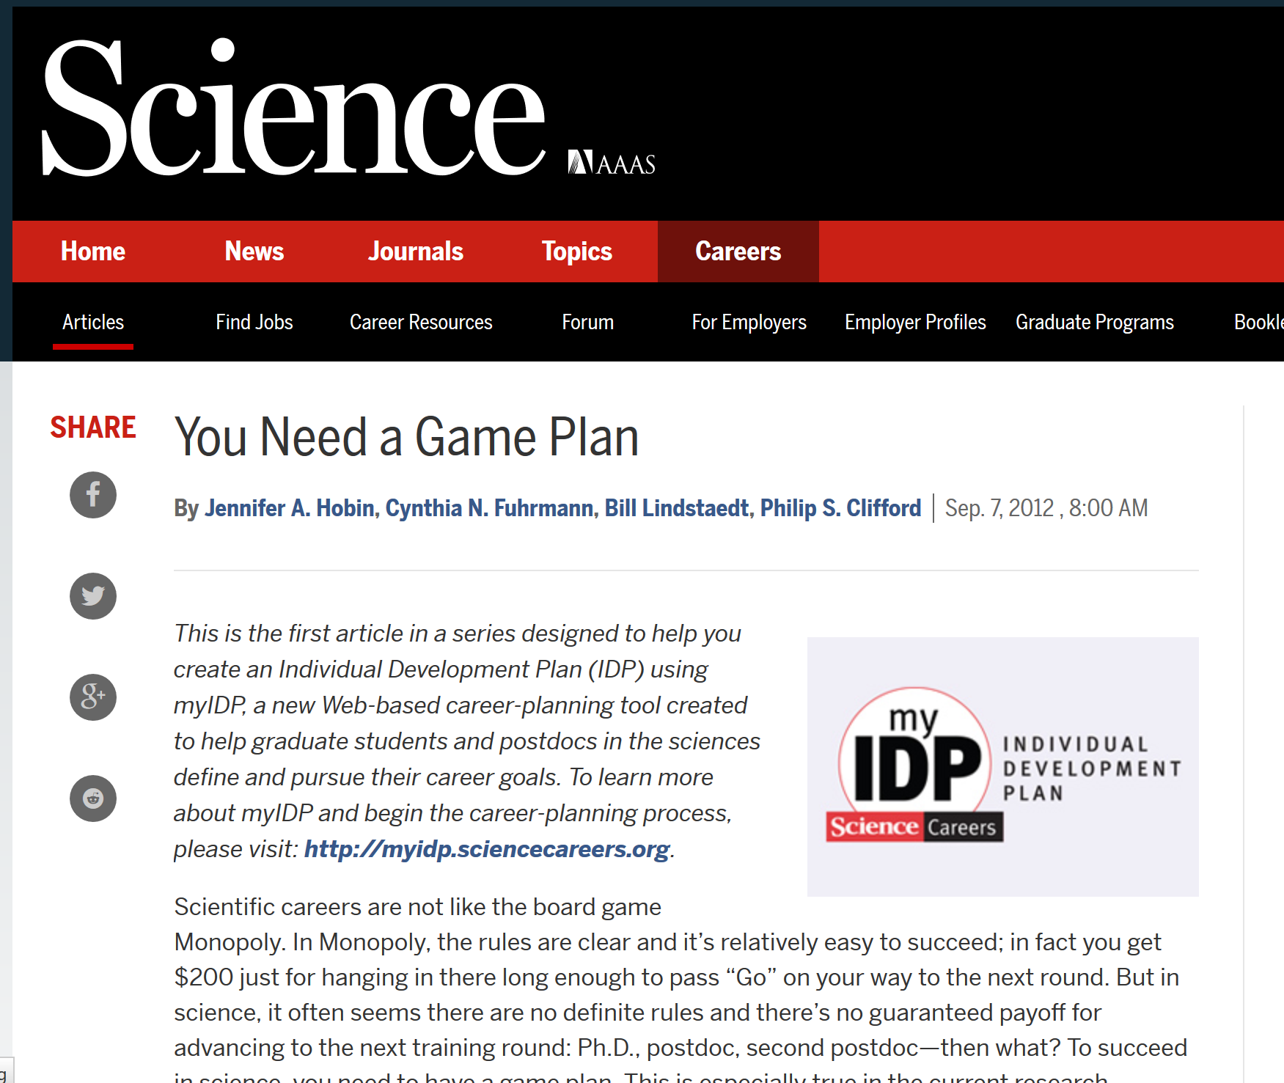
IDPs in Higher Ed?

Slide 5
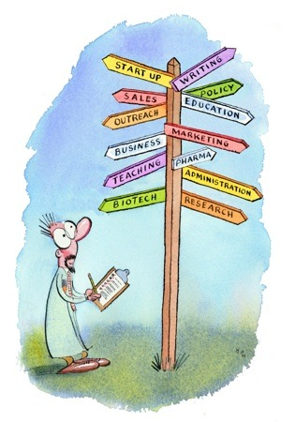
Value of IDPs in Higher Ed
Principal investigator requirement: In 2009-2012 both NSF and NIH began to require more formal structures around mentoring and professional development for trainees at the pre- and post-doctoral levels.
Yet, very little concrete evidence of the effectiveness of IDPs in higher ed settings exists
Vanderford et al. (2018) conducted an online survey among a group of 183 postdoctoral researchers.
completion rate was 54%
38% of IDP users reported that the tool was helpful to their career development.
The survey results presented here attempts to address the paucity of data
Tsai, J., Vanderford, N. & Muindi, F. Optimizing the utility of the individual development plan for trainees in the biosciences. Nat Biotechnol 36, 552–553 (2018). https://doi.org/10.1038/nbt.4155
Vanderford NL, Evans TM, Weiss LT et al. 2018. A cross-sectional study of the use and effectiveness of the Individual Development Plan among doctoral students, F1000Research 2018, 7:722 (https://doi.org/10.12688/f1000research.15154.2)

Slide 6
Consider this:
The future of the postdoc
Kendall Powell
Nature
520,
144-147
(2015)
doi:10.1038/520144a
About 65% of US PhD-holders continue into a postdoc, but only 15–20% of those move into tenure-track academic positions (Powell, 2015)
Yet, we continue to train PhDs and postdocs to do what we do (the only thing we know…), - to be professors
They need other skills – broader training, professional development, 21st century skills
We need to help students succeed regardless of their desired career path
Help set realistic expectations and goals – up front
Work with graduate students (and postdocs) on their career and professional training
Powell (2015) The future of the postdoc, Nature, 520, 144-147, doi:10.1038/520144a

Slide 7
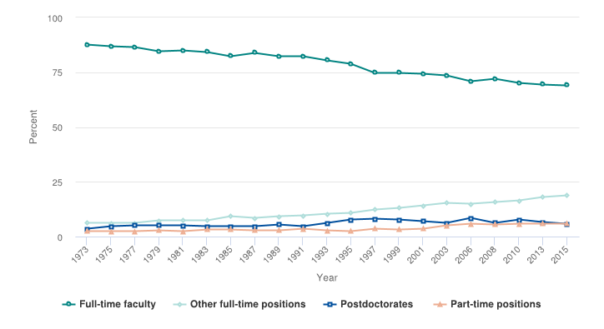
Consider this:
The future of the postdoc
Kendall Powell
Nature
520,
144-147
(2015)
doi:10.1038/520144a
S&E doctorate holders employed in academia, by type of position: 1973–2015
National Science Foundation, National Center for Science and Engineering Statistics, special tabulations (2017) of the 1973–2015 Survey of Doctorate Recipients (SDR).

Slide 8

Survey of Postdocs at OSU
At OSU, Postdoc Scholars (PDS) complete mandatory IDPs as a collaborative effort between postdoc and faculty mentor
Almost no other postdocs completed IDPs at the time of the survey
The IDP is completed within 3 months of the start of the appointment, and revisited/updated once a year after that
This compulsory structure is assumed to lead to increased communication around goal setting and expectations, as well as facilitate conversations around professional and career development, and long-term goals.
A specific goal of this IDP framework is conflict avoidance through the mutually agreed upon goals and expectations
The survey was conducted in September of 2016 – across all of campus
119 Postdoc Scholars, and 138 non-PDS postdocs

Slide 9
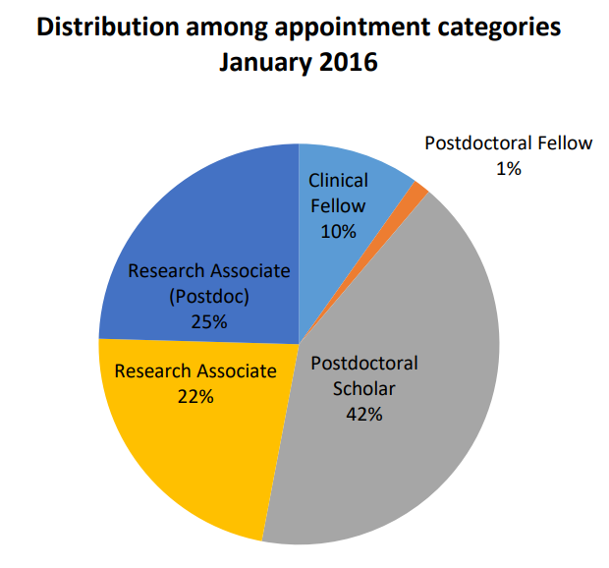
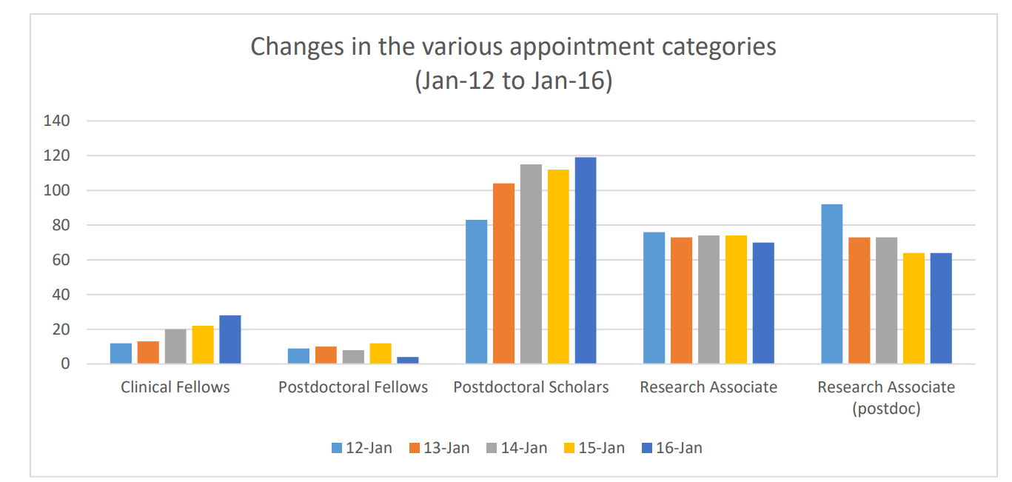
Postdocs at Oregon State
The Sept 2016 survey represents a fairly consistent distribution among the categories over 5-year period
Notes:
PDS goes up -> RA PD goes down

Slide 10
Participant Response
Appointment type | 2016 census | Survey participation | Survey participation (%)
Postdoc Scholar | 119 | 51 | 43
Research Associate (postdoc) | 64 | 23 | 36
Research Associate | 70 | 9 | 13
Postdoc Fellow | 4 | 3 | 75
Total | 257 | 86 | 33
Of 86 respondents, 51 were PDS (almost 60%) even though they only make up 46% of the population - suggesting greater engagement with the university for this category

Slide 11
Satisfaction Averages - scaled so lower score represents better outcome
Data suggests better outcome for Postdoc Scholars (using IDPs) on a considerable number of questions

Slide 12
Satisfaction Averages - scaled so lower score represents better outcome
More contact doesn’t necessarily mean helpful contact
RA as a group represents a more mature postdoc/”higher status”

Slide 13
Satisfaction Averages - scaled so lower score represents better outcome
Postdoc Fellows are now left out

Slide 14
Satisfaction Averages - scaled so lower score represents better outcome
Room for improvement

Slide 15
Some statistically significant findings (SPSS-based analysis)
Q5.1 How satisfied are you with: - The frequency of contact with your postdoctoral mentor?: Postdoc Scholar more satisfied (p=0.039)
Q6 To what extent do you agree with the following statement? - My present postdoctoral position is preparing me adequately for my current career goals. Postdoc Scholar more satisfied (agree more) (p=0.052)
Q8 To what extent do you agree with the following statement: - In general, my mentor is supportive of me attending professional development events during work hours? Postdoc Scholar more satisfied (agree more) (p=0.008)
Q17 Regardless of your plans, how effectively do you think OSU prepared you in terms of job search skills? Postdoc Scholar better prepared (p=0.010)

Slide 16
Gender (IDPs at intersections)
Q3.1 Have you faced any conflicts with your mentor around: - Expectations of my role
(p=0.022) Women experience more.
Q3.2 Have you faced any conflicts with your mentor around: - Expectations of their role
(p=0.049) Women experience more.
Q3.3 Have you faced any conflicts with your mentor around: - Authorship
(p=0.018) Women experience more.
Q7 How many professional and career development events have you attended while at OSU?
(p=0.043) Women attend fewer
Notes:
Tori: If the sig for levene’s is larger? than 0.05 we need to look at the equal variances not assumed row.
From SPSS manual: If the significance is .05 or below, use the bottom row, or “equal variances not assumed.” If the significance is above .05 use the top row

Slide 17
How to IDP?

Slide 18

How to get faculty and students on board?
At an institution with thousands of graduate students, oversight becomes challenging
Flexible (multiple options/templates/formats)
Easy-to-use (well-functioning web interface)
Offer “How to IDP” workshops
Implement as part of a certificate in Professional Development?

Slide 19


IDPs as Important Components of Grant Applications
Even before the 2009 NSF requirement, the “Broader Impact” of any proposal reviewed by NSF panels received substantial attention, and the strength or weakness of this component of the proposal often determines the fate of the application with respect to funding priorities.
IDPs support the broader impacts of a proposal

Slide 20

Postdoc Scholars at OSU (100-130)
Overseen/managed by a single individual
Fairly hands-on – significant amount of time advising and mentoring trainees on how, what, where to expand their “portfolio”
Based on their stated career goals, point them to resources, workshops, panel discussions etc.
Process is enhanced by centralized repository (calendar!) of all professional and career development opportunities on campus and online (MOOCs, webinars, etc.)
Support mentors and mentees wrt conflict management
Willingness to confront faculty if they procrastinate on completion
Feasible, but a significant work load for 100-130 postdocs.

Slide 21
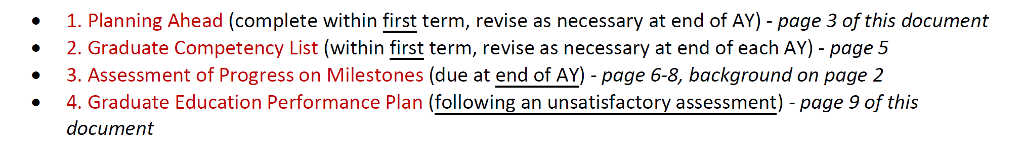
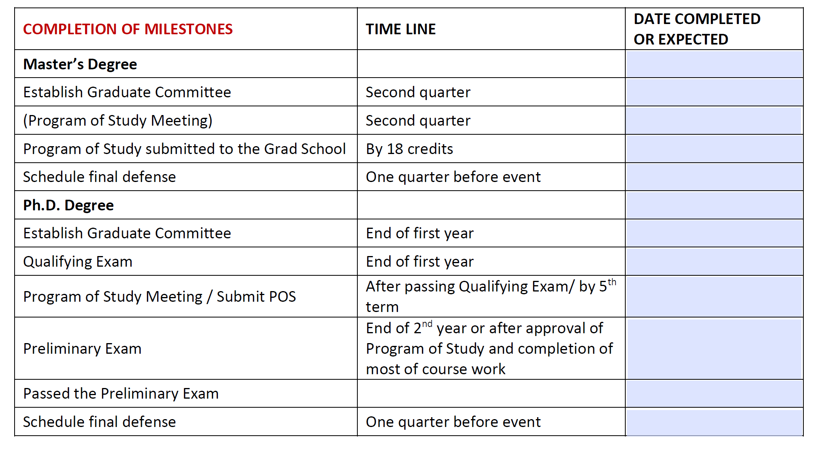
Graduate students in the College of Engineering at OSU (1000-1250)

Slide 22
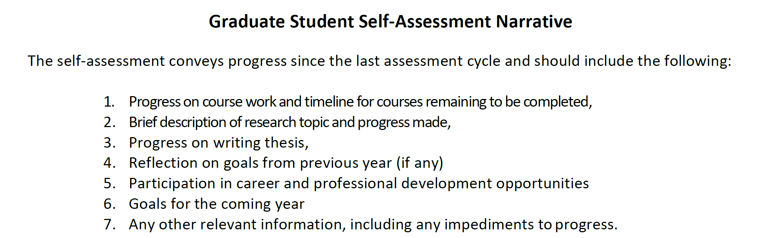
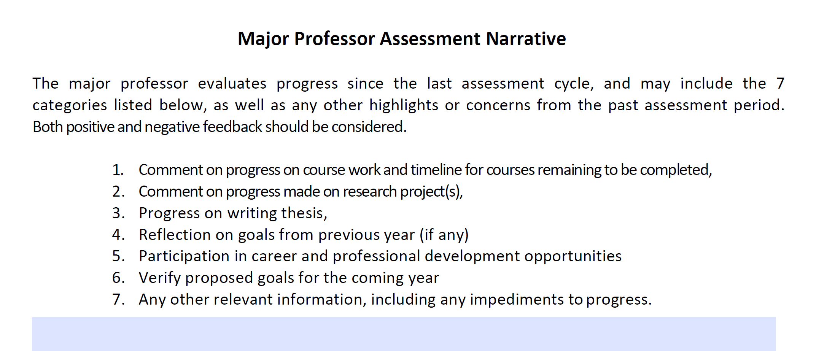

Slide 23
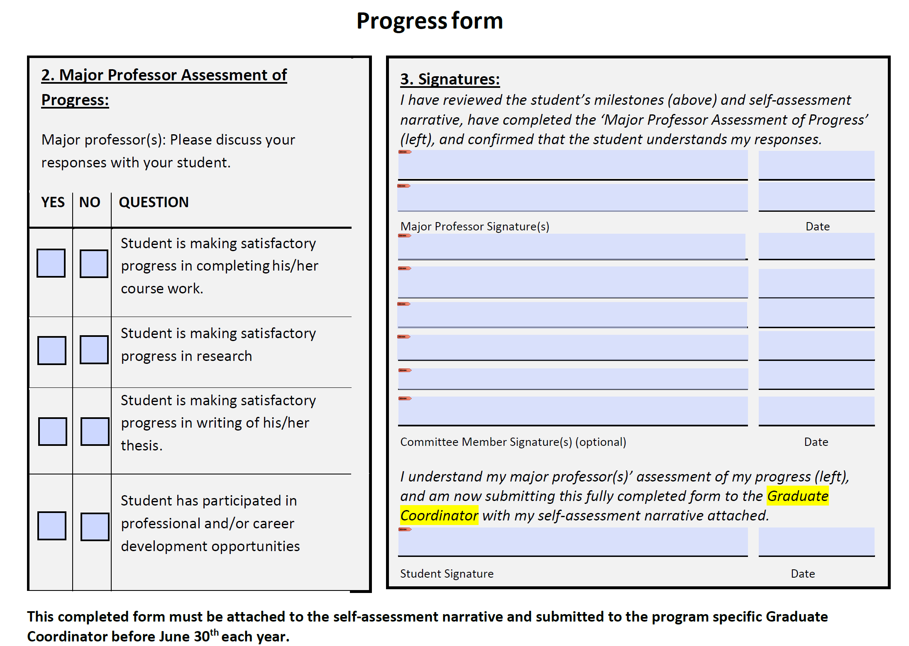

Slide 24
Summary (1/2)
Postdoc Scholars (using IDPs) reported statistically significant greater satisfaction around frequency of contact with mentor, as well as their mentor’s support of their professional development
Additionally, statistically significant improved outcomes around preparation for career goals and job search skills
Less convincing outcomes around conflict (wrt roles and authorship) (we did not ask about productivity)
Overall greater engagement with institution (contributing ~60% of survey responses) and better scores on many variables for Postdoc Scholars

Slide 25
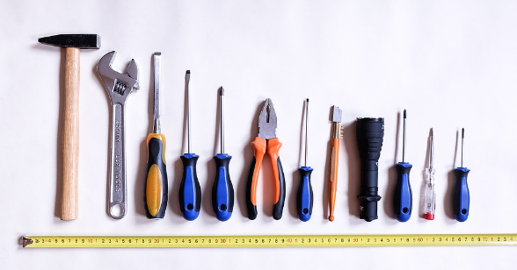
Summary (2/2)
What would it take to achieve broader implementation?
Scalable tools
More research demonstrating that the IDP is achieving stated goals – in higher ed
Incentives (NSF, NIH, institutional, etc.)
Facilitated conversations with faculty/mentors
Do postdoc survey results translate to graduate studies?

Slide 26
Thank you!
Acknowledgments
Karen Hanson, Director of Graduate Success, OSU Graduate School
Andres Lopez, Graduate Researcher (2016), OSU Graduate School
Valerie Byxbe, Undergraduate Researcher (2017), OSU Engineering

