Slide 1

Western Association of
Graduate Schools Conference Albuquerque, NM
March 9th, 2020
Ahead of the Curve!
Inge Wefes, PhD
Ray Hoobler, PhD
Professional Science Master’s Program
Biomedical Sciences and Biotechnology
Notes:
Inge Wefes, PhD
inge.wefes@ucdenver.edu
Director, Professional Science Master’s Program in Biomedical Sciences and Biotechnology
University of Colorado Denver | Anschutz Medical Campus
Ray Hoobler, PhD
ray.hoobler@utah.edu
Director, Professional Master of Science and Technology
University of Utah

Slide 2
An established solution for a growing need!
Notes:
An alternate title.
Disclaimer: We both manage PSM programs and actively promote the model
Goal of presentation:
Define the problem
Present information on the value proposition (both monetary and non-monetary) for graduate education for individuals who will primarily work in industries and businesses outside academics
Examine what employers needed in today’s workforce
What makes this hard?
Look at the traditional T-shaped model for developing talent and
the model of master’s degrees from the National Academy of Sciences, Engineering, and Medicine
Can Professional Science Master’s programs meet this need?
Types of institutions
Information on setting up a PSM program
Challenges and Opportunities
Measuring student outcomes (employment)
Provide an additional educational path (expand the educational pie)

Slide 3
An established solution for a growing need
Notes:
Transition slide

Slide 4
Thoughts “worth spreading”:
What is the need, why is it growing, and what is a solution?
How are PSM programs ahead of the curve?
Features of current PSM Programs
Setting up a PSM Program
Wefes and Hoobler 2020
An established solution for a growing need

Slide 5
1) What is the need, why is it growing, and
what is a solution?
Wefes and Hoobler 2020
An established solution for a growing need

Slide 6
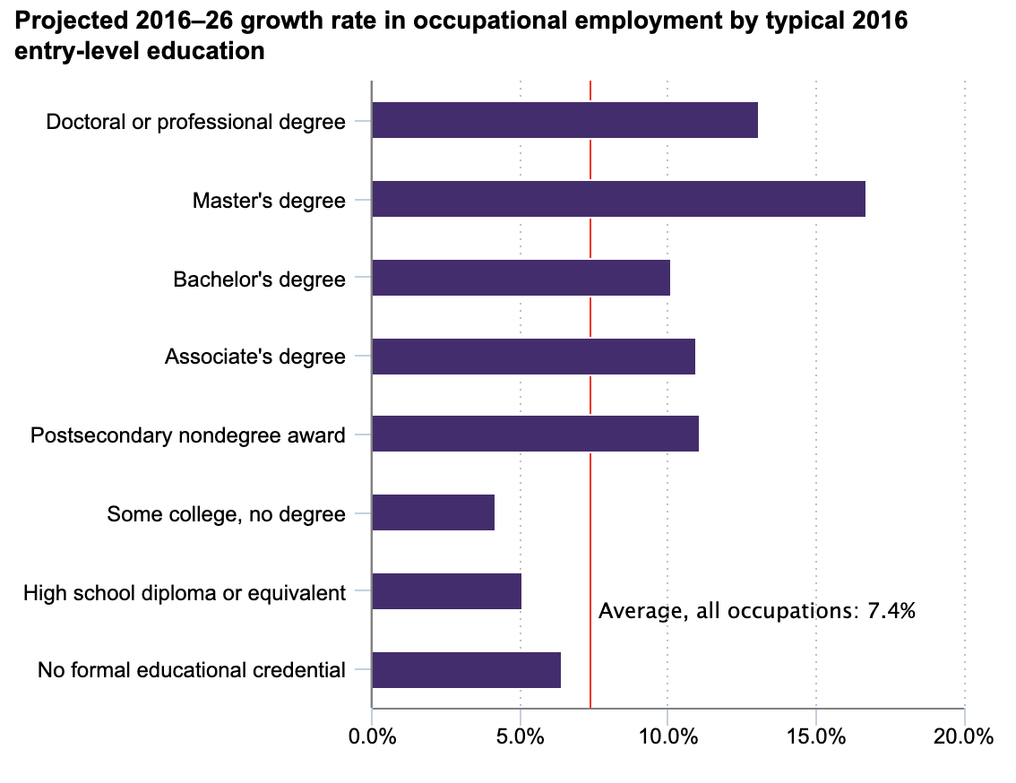
13.1%
16.7%
U.S. BUREAU OF LABOR STATISTICS
Wefes and Hoobler 2020
An established solution for a growing need
Notes:
Look at growth first
Increasing need for graduate education in the workforce.
from JANUARY 2019
Occupational employment projections through the perspective of education and training

Slide 7
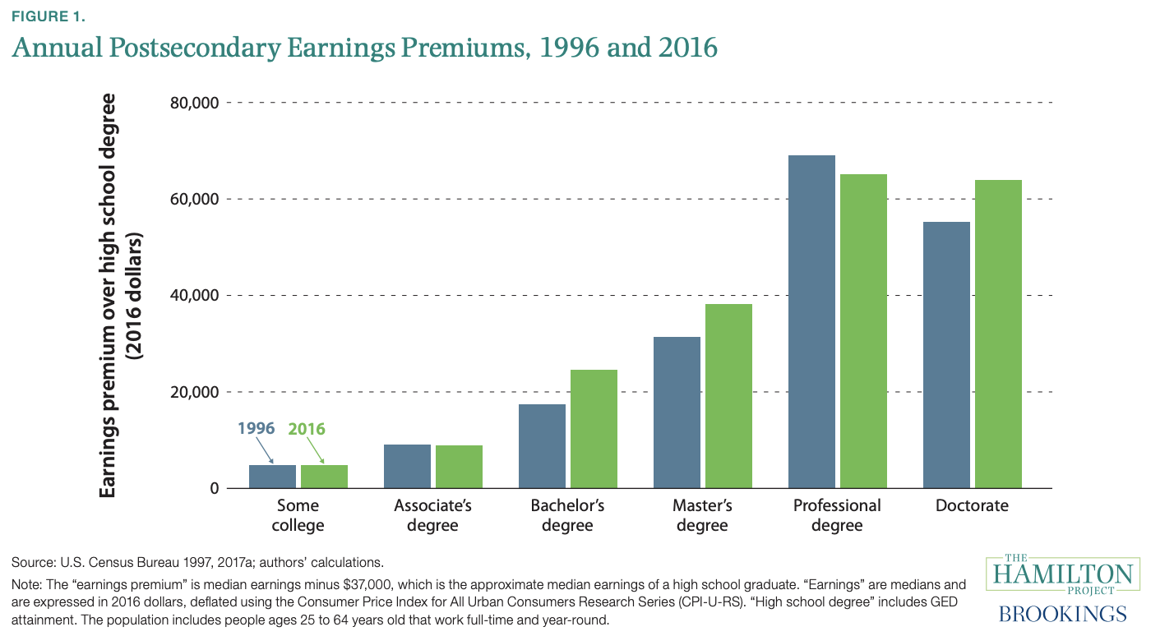
Returning to Education The Hamilton Project on Human Capital and Wages
Wefes and Hoobler 2020
An established solution for a growing need
Notes:
The financial benefits to graduate education are well documented and are growing for Master’s and Doctoral degree holders
The Hamilton Project, the Brookings Institution, and The George Washington University

Slide 8
Returning to Education The Hamilton Project on Human Capital and Wages
Wefes and Hoobler 2020
An established solution for a growing need
Notes:
Focus on Graduate Education
Earnings premium for Masters and Doctoral degree has gone up since 1996
Earnings premium for Professional degrees has gone down
$0 = High School annual earnings of $37,000
From the report.
9% of population has a Masters
3% of population has a Doctoral or Professional degree
From the report:
Source: U.S. Census Bureau 2017c; report authors’ calculations.
Note: Values reflect highest level of education attained in 2017.
Population includes civilian noninstitutionalized population ages 25 and older.
In 2014 about 5 percent of the population had some graduate school but no graduate degree; changes to the questionnaire in 2015 preclude this calculation for 2017.
Associates degree (for example: AA, AS)
Bachelor’s degree (for example: BA. BS)
Master’s degree (for example: MA, MS, MEng, MEd, MSW, MBA)
Professional degree beyond bachelor’s degree (for example: MD, DDS, DVM, JD)
Doctorate degree (for example, PhD, EdD)

Slide 9
More than money!
There are also societal benefits created by higher-level education.
greater civic engagement,
societal well-being,
Longevity and health,
regional economic prosperity.
We should be exploring ways
to increase the supply of high-quality graduate education.
In Defense Of The Master's Degree
Wefes and Hoobler 2020
An established solution for a growing need
Notes:
Civic engagement: working to make a difference in the civic life of our communities and developing the combination of knowledge, skills, values and motivation to make that difference.
Societal well-being: the extent to which you feel a sense of belonging and social inclusion; a connected person is a supported person in society.
Longevity and Health: increasing life expectancy among the college educated
Regional economic prosperity: degree holders enable important economic growth for local and state economies in terms of increased earnings, buying power, and productivity

Slide 10
More than money!
In Defense Of The Master's Degree
Wefes and Hoobler 2020
An established solution for a growing need
Notes:
Civic engagement: working to make a difference in the civic life of our communities and developing the combination of knowledge, skills, values and motivation to make that difference.
Societal well-being: the extent to which you feel a sense of belonging and social inclusion; a connected person is a supported person in society.
Longevity and Health: increasing life expectancy among the college educated
Regional economic prosperity: degree holders enable important economic growth for local and state economies in terms of increased earnings, buying power, and productivity

Slide 11

Greater civic engagement
This Photo by Unknown Author is licensed under CC BY-NC-ND
Wefes and Hoobler 2020
An established solution for a growing need
Notes:
Civic engagement: working to make a difference in the civic life of our communities and developing the combination of knowledge, skills, values and motivation to make that difference.
Societal well-being: the extent to which you feel a sense of belonging and social inclusion; a connected person is a supported person in society.
Longevity and Health: increasing life expectancy among the college educated
Regional economic prosperity: degree holders enable important economic growth for local and state economies in terms of increased earnings, buying power, and productivity

Slide 12

Societal well-being
This Photo by Unknown Author is licensed under CC BY-SA-NC
Wefes and Hoobler 2020
An established solution for a growing need
Notes:
Civic engagement: working to make a difference in the civic life of our communities and developing the combination of knowledge, skills, values and motivation to make that difference.
Societal well-being: the extent to which you feel a sense of belonging and social inclusion; a connected person is a supported person in society.
Longevity and Health: increasing life expectancy among the college educated
Regional economic prosperity: degree holders enable important economic growth for local and state economies in terms of increased earnings, buying power, and productivity

Slide 13


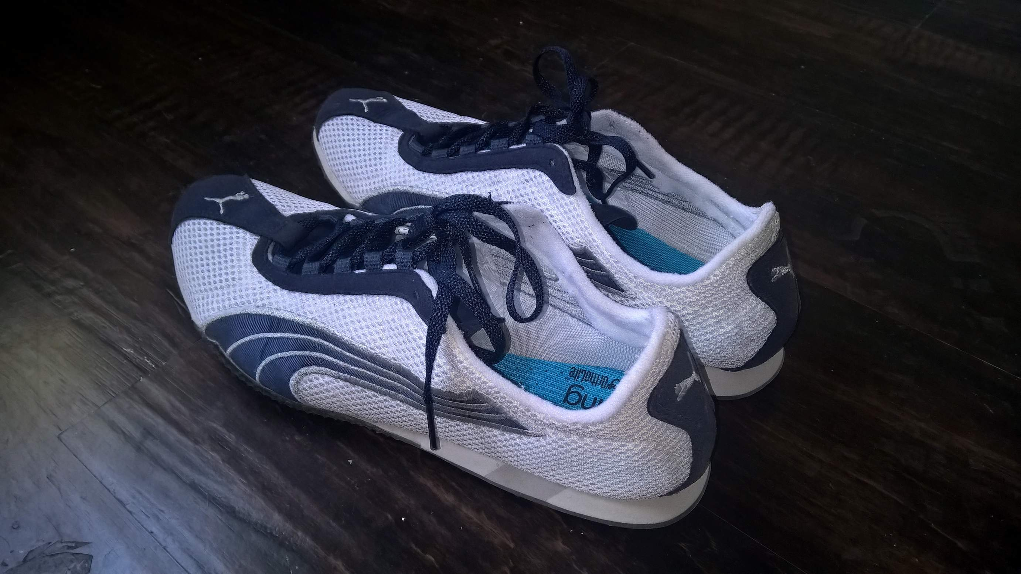
Longevity and health
This Photo by Unknown Author is licensed under CC BY-SA-NC
This Photo by Unknown Author is licensed under CC BY
This Photo by Unknown Author is licensed under CC BY-NC-ND
Wefes and Hoobler 2020
An established solution for a growing need
Notes:
Civic engagement: working to make a difference in the civic life of our communities and developing the combination of knowledge, skills, values and motivation to make that difference.
Societal well-being: the extent to which you feel a sense of belonging and social inclusion; a connected person is a supported person in society.
Longevity and Health: increasing life expectancy among the college educated
Regional economic prosperity: degree holders enable important economic growth for local and state economies in terms of increased earnings, buying power, and productivity

Slide 14
Longevity and health
This Photo by Unknown Author is licensed under CC BY-SA-NC
This Photo by Unknown Author is licensed under CC BY
This Photo by Unknown Author is licensed under CC BY-NC-ND
Wefes and Hoobler 2020
An established solution for a growing need
Notes:
Civic engagement: working to make a difference in the civic life of our communities and developing the combination of knowledge, skills, values and motivation to make that difference.
Societal well-being: the extent to which you feel a sense of belonging and social inclusion; a connected person is a supported person in society.
Longevity and Health: increasing life expectancy among the college educated
Regional economic prosperity: degree holders enable important economic growth for local and state economies in terms of increased earnings, buying power, and productivity

Slide 15
Regional economic prosperity
Economic Growth
Increased earnings
Buying power
Productivity
Wefes and Hoobler 2020
An established solution for a growing need
Notes:
Civic engagement: working to make a difference in the civic life of our communities and developing the combination of knowledge, skills, values and motivation to make that difference.
Societal well-being: the extent to which you feel a sense of belonging and social inclusion; a connected person is a supported person in society.
Longevity and Health: increasing life expectancy among the college educated
Regional economic prosperity: degree holders enable important economic growth for local and state economies in terms of increased earnings, buying power, and productivity

Slide 16
LinkedIn: 2018 Workplace Learning Report
The Rise and Responsibility of Talent Development in the
New Labor Market
Wefes and Hoobler 2020
An established solution for a growing need
Notes:
NEED A TRANSITION SLIDE

Slide 17
“ Workers . . . will spend more time on activities that machines are less capable of, such as managing people, applying expertise, and communicating with others . . . requiring more social and emotional skills and more advanced cognitive capabilities, such as logical reasoning and creativity.”
- McKinsey & Company
https://learning.linkedin.com/content/dam/me/learning/en-us/pdfs/linkedin-learning-workplace-learning-report-2018.pdf
Wefes and Hoobler 2020
An established solution for a growing need
Notes:
Additional needs highlighted

Slide 18
“ Workers . . . will spend more time on activities that machines are less capable of, such as managing people, applying expertise, and communicating with others . . . requiring more social and emotional skills and more advanced cognitive capabilities, such as logical reasoning and creativity.”
- McKinsey & Company
https://learning.linkedin.com/content/dam/me/learning/en-us/pdfs/linkedin-learning-workplace-learning-report-2018.pdf
Wefes and Hoobler 2020
An established solution for a growing need

Slide 19
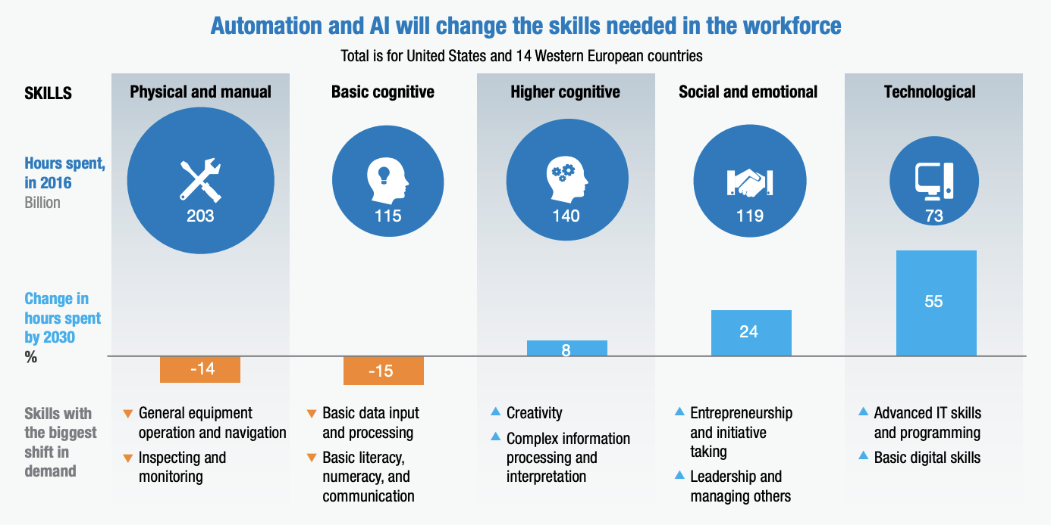
SKILL SHIFT AUTOMATION AND THE FUTURE OF THE WORKFORCE - DISCUSSION PAPER MAY 2018 – McKinsey & Company
Wefes and Hoobler 2020
An established solution for a growing need
Notes:
Many areas of work will change; focus on ”social and emotional” as it is related to non-technical skills.
With increasing automation, these skills have become more important.

Slide 20
SKILL SHIFT AUTOMATION AND THE FUTURE OF THE WORKFORCE - DISCUSSION PAPER MAY 2018 – McKinsey & Company
Wefes and Hoobler 2020
An established solution for a growing need
Notes:
Many areas of work will change; focus on ”social and emotional” as it is related to non-technical skills.
With increasing automation, these skills have become more important.
Prediction is for a 24% increase in hours spent undertaking ”social and emotional” activities.
These areas are typically not stressed in STEM undergraduate education
Social and emotional skills can’t be automated.

Slide 21
2) How are PSM Programs ahead of the curve?
Wefes and Hoobler 2020
An established solution for a growing need

Slide 22
Transformative, T-shaped Training
for Workforce Readiness
Wefes and Hoobler 2020
An established solution for a growing need

Slide 23

Transformative, T-shaped Training
for Workforce Readiness
PROFESSIONAL SKILLS
TRAINING
S
T
E
M
Wefes and Hoobler 2020
An established solution for a growing need
Notes:
T-shaped training originated with IBM.
Reference?

Slide 24
Transformative, T-shaped Training
for Workforce Readiness
Transformative, because they require a strong education in traditional or emerging STEM disciplines
PROFESSIONAL SKILLS
TRAINING
S
T
E
M
T-shaped, because they also require broad training in professional skills
Training (hands-on ) that links the STEM education and the professional skills through an experiential learning opportunity, often an internship
Wefes and Hoobler 2020
An established solution for a growing need
Notes:
Transformative, because they require a strong
education in traditional or emerging STEM disciplines,
including biotechnology, cyber security, environmental
science, forensics and more.
T-shaped, because they also require broad training in
professional skills,
such as communication, project management, policy,
ethics and more. These skills are highly valued by employers.
Training (hands-on ) that links the STEM education and
the professional skills through an internship experience.
This required immersion is tailored according to the
students’ future professional aspirations. Many internship
providers hire interns as employees.

Slide 25
https://www.nap.edu/catalog/25038/graduate-stem-education-for-the-21st-century
Wefes and Hoobler 2020
An established solution for a growing need
Notes:
Released in 2019
Describes what desired qualities in Master’s degree

Slide 26
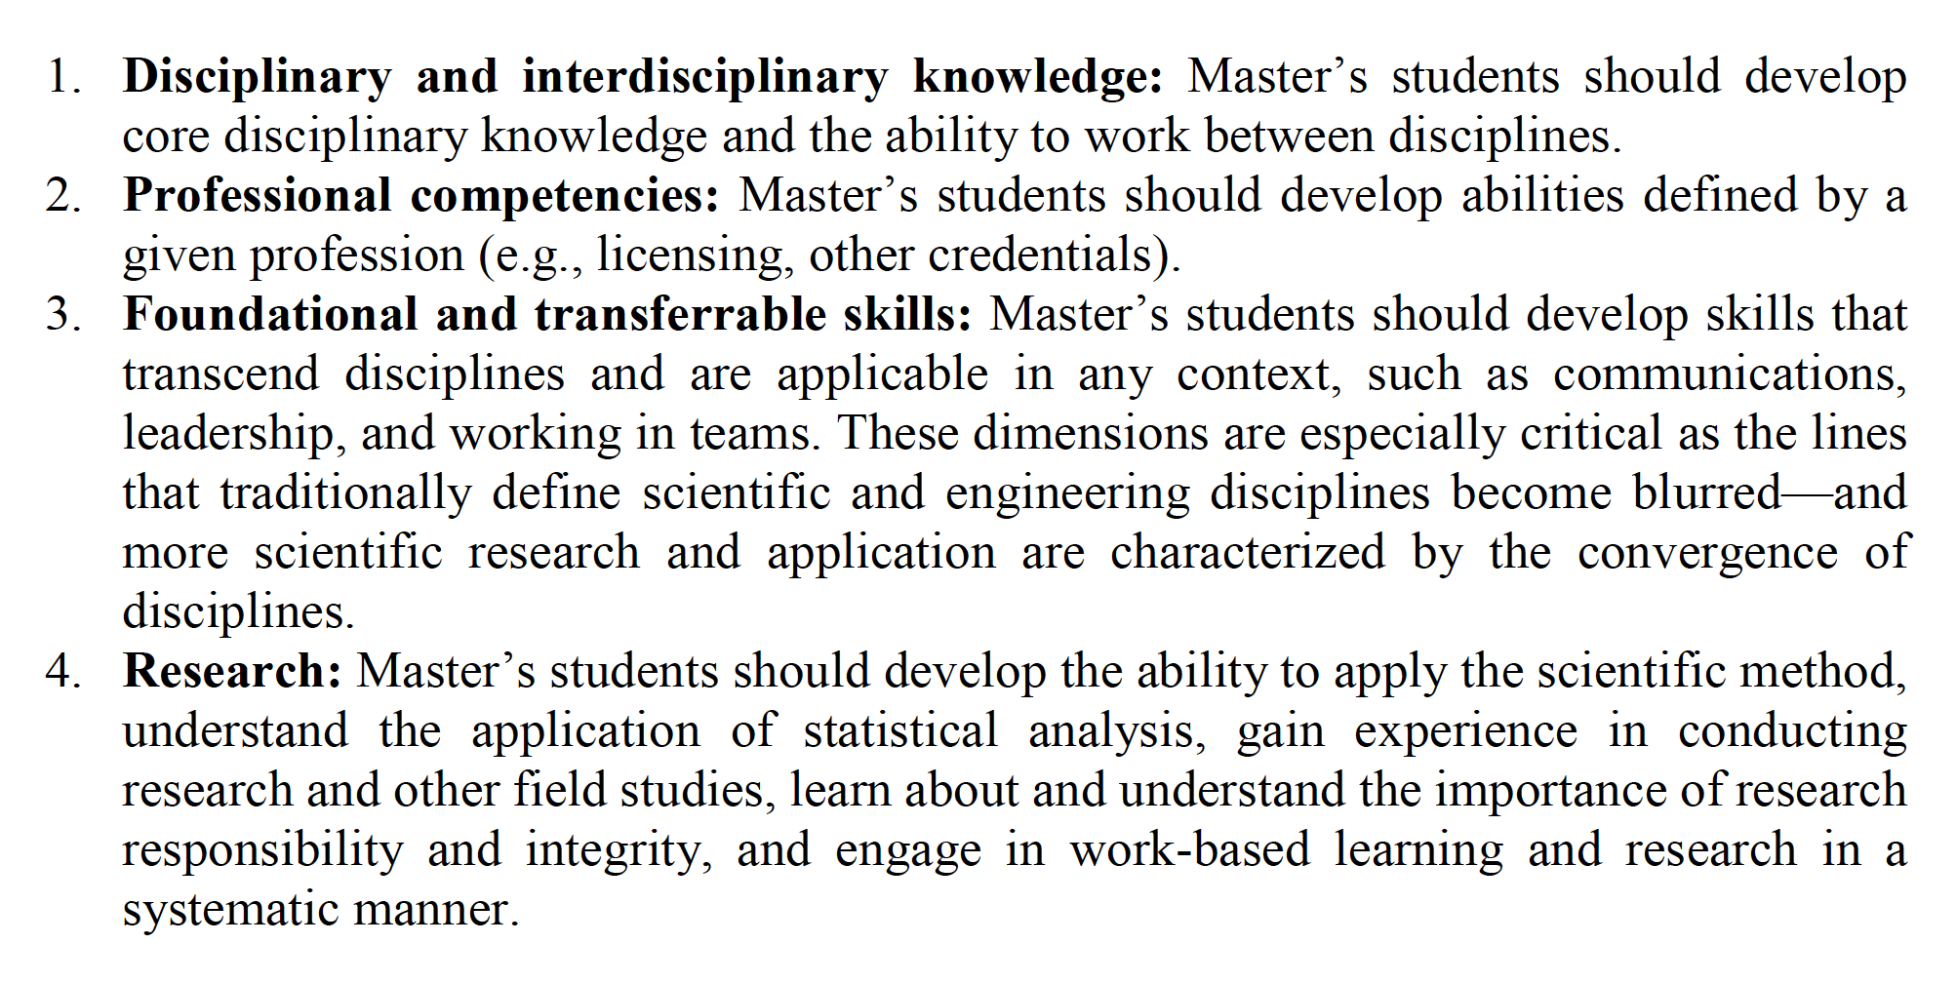
Chapter 4
The Master’s Degree
Wefes and Hoobler 2020
An established solution for a growing need
Notes:
From Chapter 4 (DON’T READ)

Slide 27
The Common Core Competency Elements for a STEM Master’s Degree
Disciplinary and Interdisciplinary Knowledge
Professional Competencies
Foundational and Transferable Skills
Research
An established solution for a growing need
Notes:
Released in 2019
Describes what desired qualities in Master’s degree

Slide 28
Disciplinary and Interdisciplinary Knowledge
PSM programs must have a majority of STEM
courses to be eligible for PSM affiliation.
Wefes and Hoobler 2020
An established solution for a growing need
Notes:
Master’s of SCIENCE degree
Focus in a core STEM discipline.

Slide 29
Professional Competencies
PSM students should explore career options and develop abilities defined
by a given profession.
Wefes and Hoobler 2020
An established solution for a growing need
Notes:
How will a master’s degree advance the students’ long-term career goals?
How can we provide information on potential career paths?
Licensing and other credentials
Facilitated via an external employer advisory board that can ask the question, what certifications are needed
Scrum Master, PMP, Six-sigma Green Belt & Black Belt(OTHERS?)
Aligns with the internship (experiential learning)

Slide 30
Foundational and Transferable Skills
PSM students should develop skills that
transcend disciplines and are widely applicable.
Wefes and Hoobler 2020
An established solution for a growing need
Notes:
Examples:
Communication skills (oral and written), including public presentations
Leadership
Laboratory Management
Operations Management
Teamwork (matrix organization)

Slide 31
Foundational and Transferable Skills
Communication
Operations/Management
Teamwork
Leadership
Wefes and Hoobler 2020
An established solution for a growing need
Notes:
Examples:
Communication skills (oral and written), including public presentations
Leadership
Laboratory Management
Operations Management
Teamwork (matrix organization)

Slide 32
Examples:
Communication skills (oral and written), including public presentations
Leadership
Laboratory Management
Operations Management
Teamwork
Wefes and Hoobler 2020

Slide 33
Research
PSM students should
develop the ability to apply the scientific method, statistical analysis;
gain experience in conducting research/field studies;
engage in work-based learning and research in a mentored setting.
Wefes and Hoobler 2020
An established solution for a growing need
Notes:
Examples of how students gain research experience:
"Internship" usually refers to a one-term work assignment, most often in the summer, but not always. Internships can be full- or part-time, paid or unpaid, depending on the career field.
"Co-op" usually refers to a multi-work term agreement with one employer; traditionally with at least three work terms alternated with school terms, resulting in a five-year degree program for what would otherwise take four years. Co-ops are traditionally full-time, paid positions.
“Capstone projects” vary from university to university, are usually more "experiential" projects where students take what they've learned throughout the course of their graduate program and apply it to examine a specific idea.
Independent study
Traditional research projects
How is the work disseminated?
Written document either as a thesis or final project report

Slide 34
Research
Internships
Co-ops
Capstone projects
Independent study
Traditional research projects
Wefes and Hoobler 2020
An established solution for a growing need
Notes:
HOW?
Examples of how students gain research experience:
"Internship" usually refers to a one-term work assignment, most often in the summer, but not always. Internships can be full- or part-time, paid or unpaid, depending on the career field.
"Co-op" usually refers to a multi-work term agreement with one employer; traditionally with at least three work terms alternated with school terms, resulting in a five-year degree program for what would otherwise take four years. Co-ops are traditionally full-time, paid positions.
“Capstone projects” vary from university to university, are usually more "experiential" projects where students take what they've learned throughout the course of their graduate program and apply it to examine a specific idea.
Independent study
Traditional research projects
How is the work disseminated?
Written document either as a thesis or final project report
An inclusive definition of research

Slide 35
3) Features of Current PSM Programs
Wefes and Hoobler 2020

Slide 36
157
Institutions
https://www.professionalsciencemasters.org/reports-statistics
Wefes and Hoobler 2020
An established solution for a growing need
Notes:
PSM programs have been implemented across many types of institutions
2017
67% Doctoral Universities

Slide 37
363
programs
https://www.professionalsciencemasters.org/reports-statistics
Wefes and Hoobler 2020
An established solution for a growing need
Notes:
Programs have diverse areas of specialization; ideally related to local industry needs
2017
Three largest areas in Biotech, Environmental Science, and Data Science (81%)

Slide 38
Growth over 20+ years
2001:
2013:
Sloan Foundation
Grant to CGS extended the PSM initiative to Master’s focused Institutions
300th program
1997:
Sloan Foundation
Grants to 14 research universities to support the founding of programs in the natural sciences and mathematics;
12 research institutions with programs in bioinformatics.
Wefes and Hoobler 2020
An established solution for a growing need
Notes:
Steady growth over 20+ years
Since Summer 2019, NPSMA affiliates PSM programs and promotes the PSM model.
Expect additional growth as Master’s degrees have recognized the value of the PSM concept in doctoral education.

Slide 39
4) Setting up a PSM Program
It takes a pioneer and a village!
Wefes and Hoobler 2020
An established solution for a growing need

Slide 40

Develop Curriculum:
Define program focus (biotech, comp. sci etc.)
Evaluate needs: University, market need and
student interest
Seek approvals: University Leadership/faculty;
emphasize revenue stream
Select or develop STEM courses
Select or develop professional development
courses
Wefes and Hoobler 2020
Notes:
INGE to simplify (or break into more slides)

Slide 41

Make connections with internship providers/employers:
Contact, meet and educate
internship providers/employers
Familiarize with PSM concept
Emphasize possible influence on
employee training before employment
Emphasize local recruitment opportunities
Wefes and Hoobler 2020

Slide 42

EXPENSES
Primary:
Program Director/Pioneer/Advisor
Professional Development courses
(instructor salaries or transfer of funds)
Secondary:
Marketing/Recruitment
Program/student events
Travel for Faculty, Staff, Students
Break-even analysis: 10 to 30 students per cohort (small to modest sized programs)
Wefes and Hoobler 2020
An established solution for a growing need

Slide 43

AFFILIATION
Power of the crowd!
Setting standards/requirements!
Official declaration that someone cares
for education in this arena!
Easier to find support/recognition by other
entities such as WAGS, CGS, AAMC, NAS!
Wefes and Hoobler 2020
An established solution for a growing need

Slide 44
BRANDING via AFFILIATION
Branding is crucial to the success of a program.
Branding can influence whether students will
accept a new the program.
Effective branding enables the student to easily identify the program because the features and benefits have been communicated effectively.
Modified from: :https://www.boundless.com/marketing/textbooks/boundless-marketing-textbook/branding-and-packaging-10/branding-74/value-of-branding-371-611/
Wefes and Hoobler 2020

Slide 45

AFFILIATION
Provides guidance for new and existing programs
Reviews and approves program affiliation
https://www.npsma.org
Wefes and Hoobler 2020
An established solution for a growing need

Slide 46
Challenges and Opportunities
Wefes and Hoobler 2020
An established solution for a growing need

Slide 47


Challenges and Opportunities
This Photo by Unknown Author is licensed under CC BY-SA-NC
This Photo by Unknown Author is licensed under CC BY-SA
Wefes and Hoobler 2020
An established solution for a growing need

Slide 48
Challenges and Opportunities
Recruitment of qualified students
Gaining institutional support
Measuring student outcomes
Engagement with the business community
Participate in workforce development
Provide an additional educational path for non-traditional students
This Photo by Unknown Author is licensed under CC BY-SA-NC
This Photo by Unknown Author is licensed under CC BY-SA
Wefes and Hoobler 2020
An established solution for a growing need

Slide 49
Measuring Student Outcomes
This Photo by Unknown Author is licensed under CC BY-SA-NC
Outcomes for PSM alumni 2013
Wefes and Hoobler 2020
An established solution for a growing need
Notes:
In higher education we talk about student outcomes, but

Slide 50
Measuring Graduate Employment
This Photo by Unknown Author is licensed under CC BY-SA-NC
Wefes and Hoobler 2020
An established solution for a growing need
Notes:
Students are primarily asking about employment after graduation

Slide 51
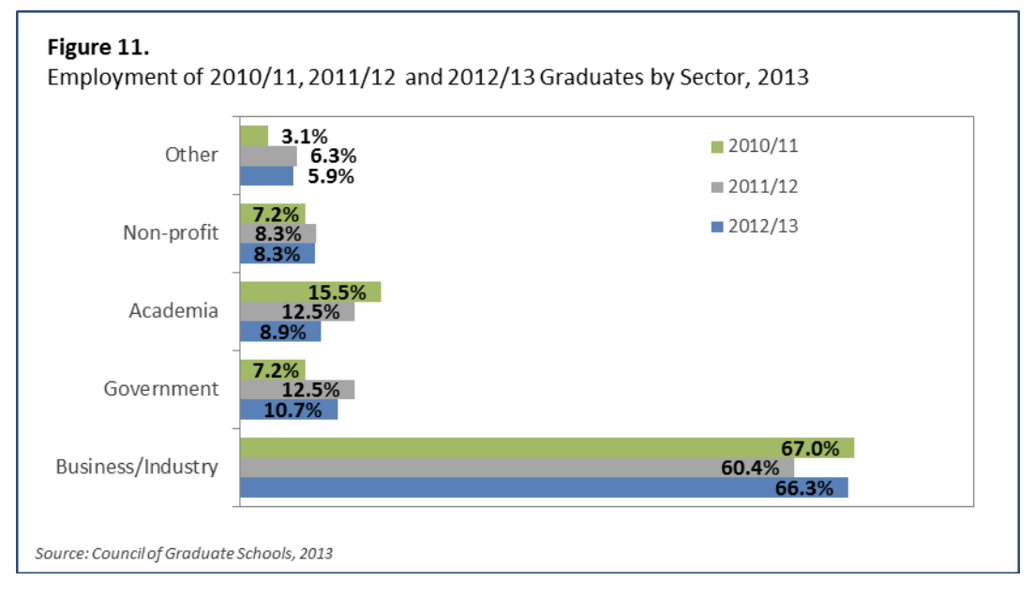
Measuring Graduate Employment
Employment of PSM graduates by Sector
This Photo by Unknown Author is licensed under CC BY-SA-NC
Outcomes for PSM alumni 2013
Wefes and Hoobler 2020
An established solution for a growing need

Slide 52
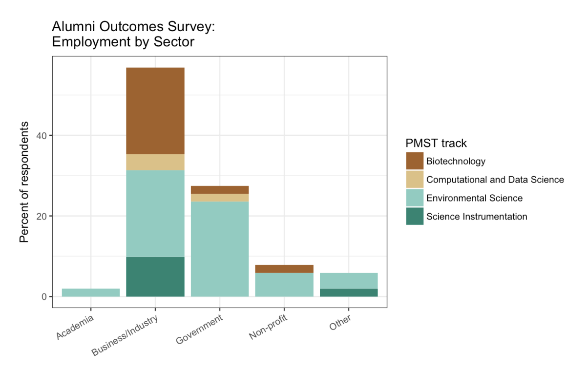
Measuring Graduate Employment
This Photo by Unknown Author is licensed under CC BY-SA-NC
Wefes and Hoobler 2020
An established solution for a growing need

Slide 53
Measuring Graduate Employment
PSM Program in
Biomedical Sciences & Biotechnology
CU Denver|Anschutz
Professional Science Master’s Program
Biomedical Sciences and Biotechnology
Wefes and Hoobler 2020

Slide 54
Challenges and Opportunities
Recruitment of qualified students
Gaining institutional support
Measuring student outcomes
Engagement with the business community
Participate in workforce development
Provide an additional educational path for non-traditional graduate students
This Photo by Unknown Author is licensed under CC BY-SA-NC
This Photo by Unknown Author is licensed under CC BY-SA
Wefes and Hoobler 2020
An established solution for a growing need
Notes:
Opportunities

Slide 55
Provide an additional educational path for non-traditional graduate students
Interested in non-academic career paths
Currently employed
Career changes
This Photo by Unknown Author is licensed under CC BY-SA
Wefes and Hoobler 2020
An established solution for a growing need
Notes:
Opportunity to expand the pool of graduate students.

Slide 56
An established solution
for a growing need!
Inge Wefes
Ray Hoobler
inge.wefes@ucdenver.edu
Director, Professional Science Master’s Program in Biomedical Sciences and Biotechnology
University of Colorado Denver | Anschutz Medical Campus
ray.hoobler@utah.edu
Director, Professional Master of Science and Technology
The University of Utah

Slide 58
PSM affiliation requirements
Part 1: Program Information.
Part 2: STEM information.
Part 3: Professional Competencies.
Part 4: Foundational and Transferable Skills.
Part 5: Research
Part 6. Engagement with PSM Community.
Part 7: Letter of Support.
Part 1: Program Information.
Part 2: STEM information.
Part 3: Professional Competencies.
Part 4: Foundational and Transferable Skills.
Part 5: Research
Part 6. Engagement with PSM Community.
Part 7: Letter of Support.

