Slide 1
The Best Practices of a Truly Diversified Graduate Campus, from Admissions to Student Services

Slide 2
Today’s Presenters
Kerry Callahan Mandulak, PhD, CCC-SLP
Associate Professor & Chair of Graduate Admissions
Becky White Associate Vice President, Enrollment Management Solutions
MODERATOR

Slide 3
Private, liberal arts university in Forest Grove, Oregon
Total undergraduate and graduate enrollment: 3,875 students

Slide 4
Evolving Admissions Processes to Foster a Culture of Diversity and Inclusion
Notes:
How do institutions reduce bias and remove barriers in the admissions process?
At this point, Kerry will speak to some of the strategies she’s employed at Pacific University

Slide 5
Inside Graduate Admissions (Posselt, 2016)
“Faculty experience admissions work as politically, cognitively, and procedurally difficult, because it positions them between impulses, principles, and pragmatism” (p. 18)
Notes:
It’s about the applicants, but it’s also about us
What do we value? What are our biases? We have them! We can’t deny them. But we can recognize them!
Legal implications / landscape … it’s hard!!

Slide 6




The Four Tenets of Holistic Review:
Broad Selection Criteria
Go Beyond Academics
Consider Potential
Mission-related Interests/Goals for Diversity
Notes:
Holistic Admissions is one way to get to know the whole student better, and make a more informed decision.
The AAMC offers these four tenets:
Applicant selection criteria are broad, clearly linked to school mission and goals, and promote numerous aspects of diversity as essential to excellence
Selection criteria include experiences and attributes as well as academic performance
Schools consider each applicant’s potential contribution to both the school and the field of medicine
Race and ethnicity may be considered only when aligned with mission-related educational interests and goals associated with student diversity; and when considered as a broader mix of factors....
Source

Slide 7

“Best” Students to “Best Fit” Students (Sedlacek, 2017)
Paradigm shift
Increasing diversity in a more sophisticated way
What does your program and faculty value in students?
Non-cognitive variables (William Sedlacek)
Positive self-concept or confidence
Realistic self-appraisal
Understand and deals with racism
Prefers long term goals to short-term or immediate needs
Availability of strong support person
Successful leadership experience
Demonstrated community service
Knowledge acquired in a field

Slide 8
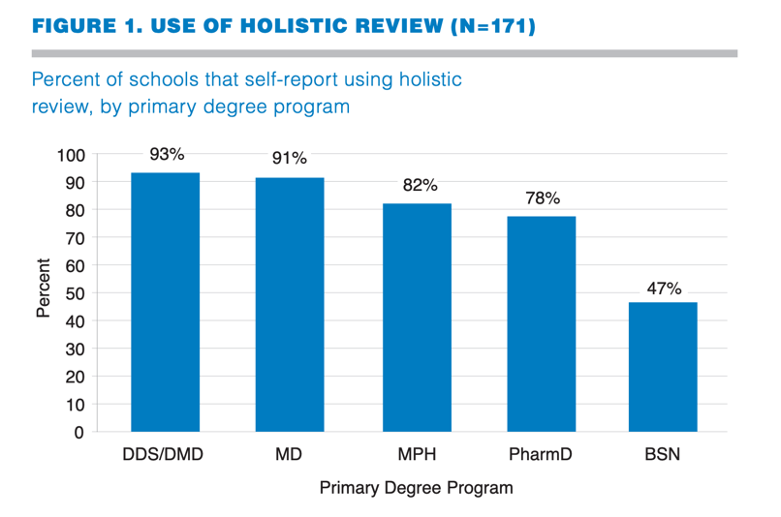

Holistic Admissions in the Healthcare Field
Source
Notes:
A foundational study from the Urban Universities for Health in 2014 surveyed programs within the healthcare field about their use of holistic review and its impact on their incoming classes. You can see here that use varies by discipline.
Source

Slide 9
The Impact of Holistic Review on Diversity Outcomes
Change in diversity for schools self-identified as using holistic review, by holistic review score
Source
Notes:
School self-reporting use of holistic review overwhelming say that it increased diversity.
Once Kerry is done here, Moderator will hand it over to Narce to talk about supporting diversity once students are enrolled

Slide 10
Foundational Resources
American Association of Medical Colleges
https://www.aamc.org/initiatives/holisticreview/
American Association of Colleges of Nursing
https://www.aacnnursing.org/Diversity-Inclusion/Holistic-Admissions
American Dental Education Association
https://www.adea.org/HolisticReview/About.aspx
https://www.adea.org/HolisticReview/Race-Conscious-and-Race-Neutral-Policies.aspx
William Sedlacek (non-cognitive variables)
http://williamsedlacek.info/publications/articles/employing1.html
Council of Graduate Schools
https://cgsnet.org/ckfinder/userfiles/files/CGS_HolisticReview_final_web.pdf
UU HEALTH Study
http://urbanuniversitiesforhealth.org/media/documents/Holistic_Admissions_in_the_Health_Professions.pdf

Slide 11

After Acceptance: How Can Your Institution Prepare All Incoming Students For Success?
Notes:
Narce will talk about her work as DEI officer and her recent move to VP of Student Success
Narce will speak to the unique supports all students need after they’ve been accepted to an institution.

Slide 12
Student of Color at Predominantly White Colleges Experience:
Marginalization
Alienation
Isolation
Loneliness
(Fisher & Harman, 1995:Loo & Rolision, 1986; McCormack, 1995; Tan, 1994).

Slide 13
These Experiences Collectively Reflect a General Lack of Belongingness on Campus
Belongingness, in this sense, is defined as a subjective feeling of interpersonal closeness within a given social context (Lee & Robbins, 1995).

Slide 14
Belonging = Student Retention
Sense of belonging is critical to the academic and social adjustment of college students (Astin, 1993; Tinto, 1993).
Belongingness can be related to psychological distress among college students. McCarthy, Pretty, and Catano (1990) and Robbins, Lese, and Herrick (1993)

Slide 15
Retention Actions To Retain Diverse Students!
Recommendation:
Pre/post survey for sense of belonging, assure it has diverse/climate questions (use your Institutional research office).
Examine the effectiveness of your plan!
What does a welcome look like for new students?
What type of orientations do you have? Are they White-centered?
Who are your students? Examine the data.

Slide 16
Continuation!
Do you have faculty who are not only culturally responsive but also have cultural humility?
Are you hiring faculty / staff who already have the tools & compassion to help with student retention?
Are these type of questions being asked in your interview process?
What is the ongoing plan to continue to develop best practices to serve diverse students?
How are your current diverse faculty validated?

Slide 17
Practice to Theory to Practice (Knefelkamp, Golec, & Wells, 1985)
Identify opportunities
Determine goals & outcomes
Know your student/data!
Analyze relevant student characteristics
Analyze characteristics of your educational environment
Identify potential sources of challenges (be proactive)
Design interventions using methods that will encourage (retention)
Evaluate the outcomes of your retention strategies
Redesign your strategies & interventions if needed

Slide 18

Transparent Teaching

Slide 19
Transparent teaching methods help students understand
HOW and WHY
they are learning course content in particular ways.
https://www.aacu.org/publications-research/periodicals/transparency-teaching-faculty-share-data-and-improve-students

Slide 20
Why Transparent Teaching?
Undergraduate
Recent findings : just 2 instances of transparent instruction has significant, equitable benefits for UG students
long-term effects
significantly enhanced student success
Graduate
HOLISTIC REVIEW for admissions that increases the diversity and representation within our cohort
many different kinds of learners
wide variety of educational backgrounds / experiences
Source: https://tilthighered.com

Slide 21
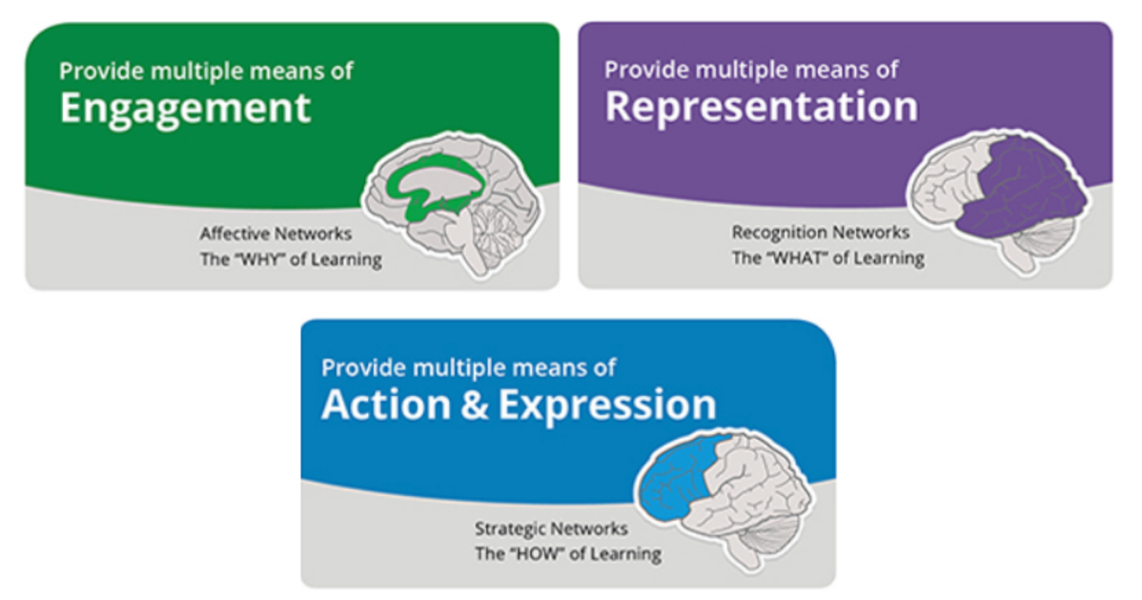
Universal Design for Learning – INCLUSIVE PEDAGOGY
Source: https://dcal.dartmouth.edu/resources/teaching-learning-foundations/universal-design-education

Slide 22
Universal Design for Learning
Teaching Framework
Learner Variability
Accessible Education
Range of learner background / needs
Proactive approach
Not retro-fitting
Positively influence students understanding of their own capabilities
Address student needs
Increased diversity of students on multiple dimensions

Slide 23
What unique support do students of all type need once they’ve been accepted?
Notes:
Narce will talk about her work as DEI officer and her recent move to VP of Student Success
Narce will speak to the unique supports all students need after they’ve been accepted to an institution.

Slide 24
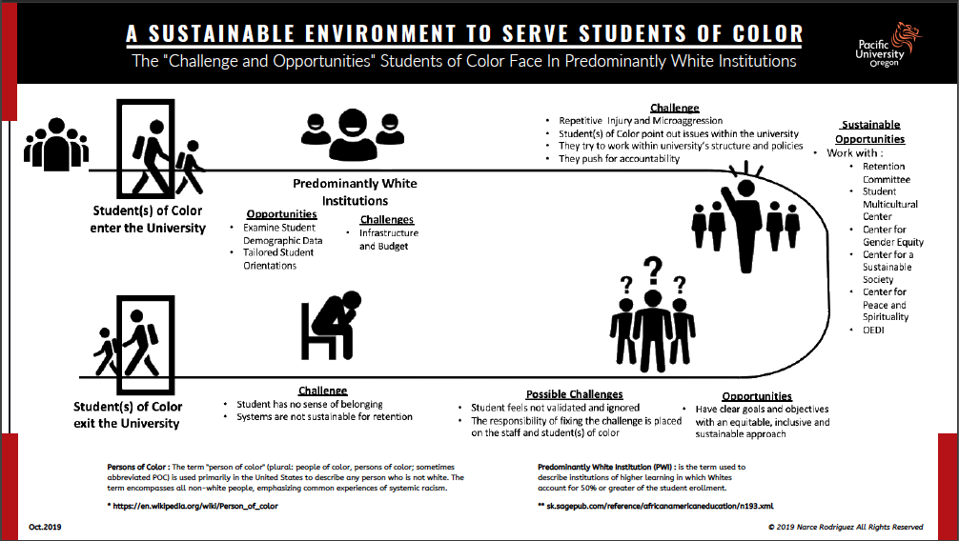
Notes:
Narce to speak here
Infographic describing the BIG PICTURE of retention and student services for students who are diverse (in particular, students of color at a PWI)

Slide 25
Q & A
Notes:
During this section, we’ll take questions from the audience. We’ll also pose “stock questions” that we write and share with the panelists in advance.

Slide 26
Thank You.
Kerry Callahan Mandulak, PhD, CCC-SLP
mandulak@pacificu.edu
Becky White
bwhite@liaisonedu.com

